Slide 1
Project :Credit Application Chatbot by Adrian, Eric, Saiful, Shrenik and Tarang

Slide 2
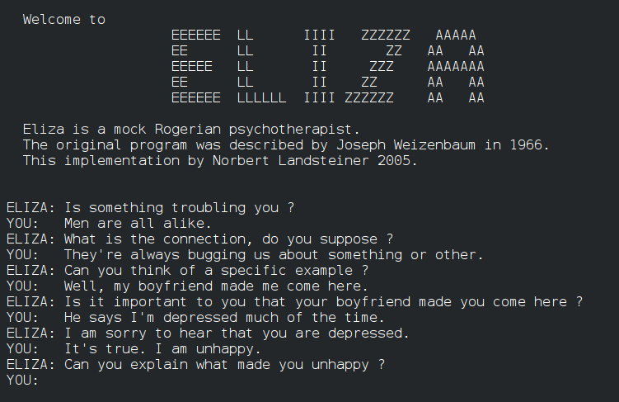
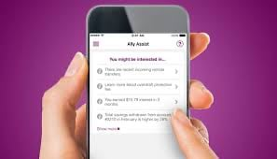
Brief History of Chatbot:
ELIZA was the very first chatbot as mentioned above. It was created by Joseph Weizenbaum in 1966 and it uses pattern matching and substitution methodology to simulate conversation.
Ally Bank was one of first who started to use Chatbots for Personalized customer service in 2015.

Slide 3
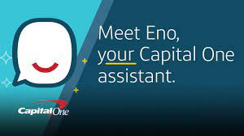
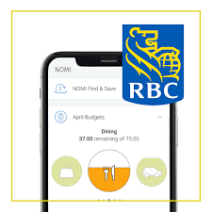
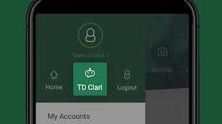
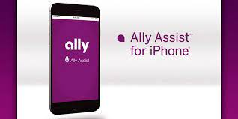

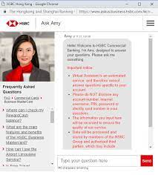
Chatbots used by Financial Institutes
Ally Assist by Ally Bank
Amy by HSBC
Ceba by Commonwealth Bank (Australia)
Citi Bot SG by Citi
Clari by TD
Eno by Capital One
Nomi by RBC
Scotia Bank Chatbot

Slide 4
Project analysis slide 2
Project Objective
Comparing two predictive models used in Machine Learning namely - Random Under Sampling and Cluster Centroid Under Sampling
PROJECT
Use data from Kaggle
Using Using Amazon Sagemaker, Train and split test to develop models & visualization to evaluate performance.
Create presentation showcasing the comparison for two predictive models.

Slide 5
Project analysis slide 3
Project Tasks
Data was found using Kaggle
Dataset comprised of Credit applications submitted to a financial institution
Data was biased – Most of the applicants’ creditworthiness was indicating approval than rejection, hence Random Undersampling and ClusterCentroid Undersampling were used as predictive models.
Finding Data
Build the Chatbot
Plug model into chatbot
Run the Chatbot
Build chatbot using Amazon Lex

Slide 6
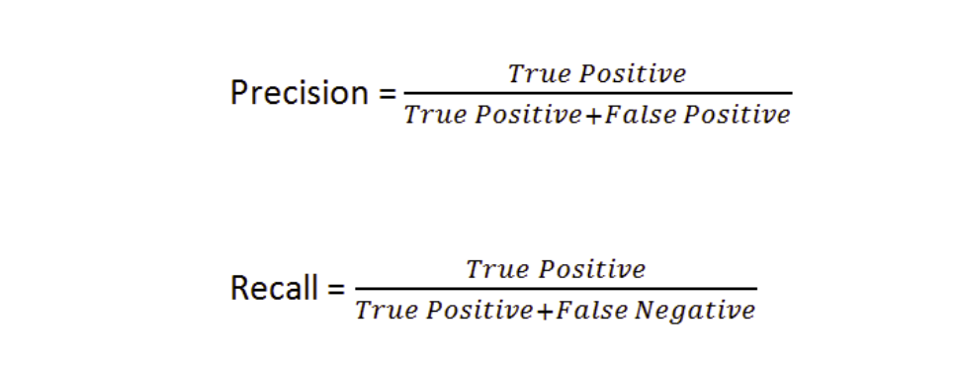
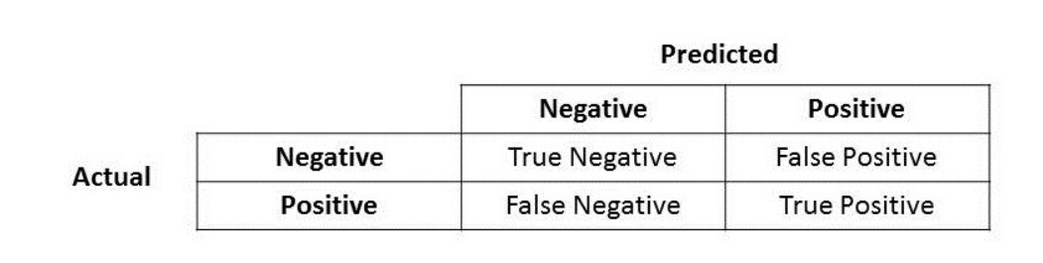
Formula

Slide 7
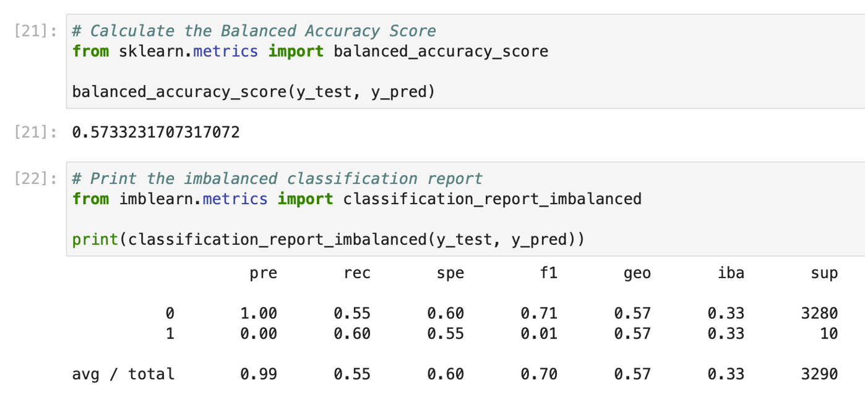
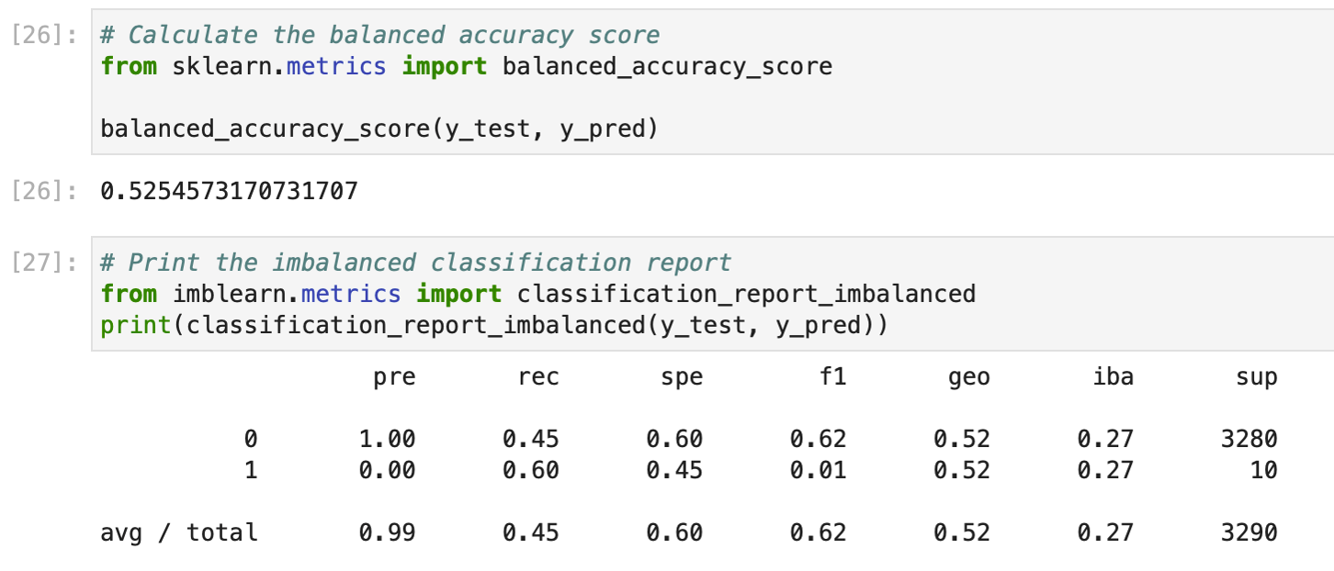
Project Tasks
Random Undersampling Vs. ClusterCentroid Undersampling
Comp
Using Sagemaker Train and Split Data
Comparing two Datasets

Slide 8
Thank You

